Slide 1

Fakhri Nurrahmadi --- Data Analyst
Greetings!
My name is Fakhri Nurrahmadi,
A Data Analyst / Data Scientist with roughly 1 year of experience,
most recently in the Finance industry, with a Data Science Certification.
Actively looking for new challenges to continue building towards a solid data skillset ☺
Link to Website
Hard Skills:
Excel / Sheets
Python
SQL
Tableau / Data Studio
Topics:
Data Analysis
Business Intelligence
Data Science

Slide 2
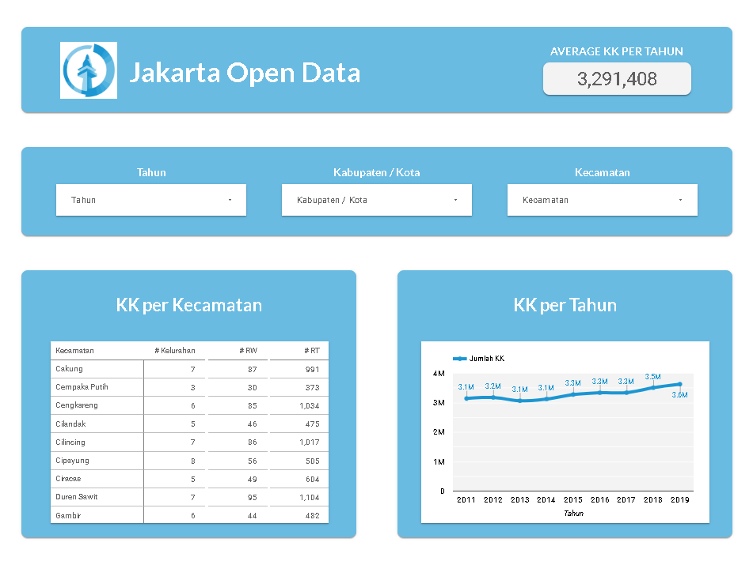
Jakarta Population Data
The following dashboard was created in attempt to display the continuous increase of Jakarta’s population. The data is obtained from the Jakarta Open data website.
The data only shows up to the number of family registries, however we can still see that an upward trend of family registries per year in Jakarta.
The dashboard allows you to filter the data by the year, the city, and/or the district.
Tools used:
Json files
Python
Google Sheets
Google Data Studio
Link to Documentation
Link to Dashboard

Slide 3
Cohort Analysis - Sales
A cohort analysis is an analytical technique which involves categorizing groups of people and monitoring their changes over time.
In this particular case, a cohort analysis is performed to see the sum of sales amount of each cohort group over time.
The analysis can be found in the documentation
Tools used:
Csv file
Microsoft Excel
Link to Documentation
Link to Dashboard

Slide 4
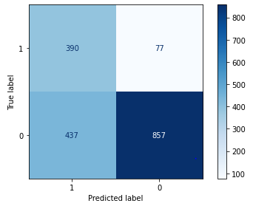
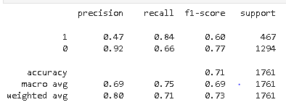
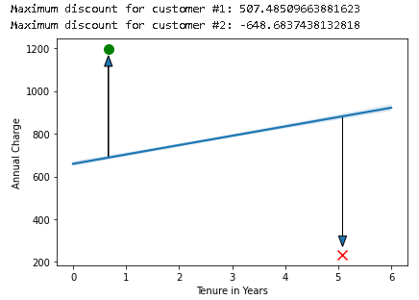
Customer churn prediction
By way of machine learning modelling, we can predict customers that have tendencies to churn based on their data.
In this particular case study, customer churn prediction is performed for a telecommunication company to retain valuable customers.
Classification Report
Confusion Matrix
A discount program is devised to retain churning customers.
Discounts are only given to churning customers that are valuable, and their value is calculated using regression analysis.
Tools used:
Python
A Gaussian Naïve Bayes model was used to predict churning customers.
The model performs with a recall score of 84% for churning customers, meaning that there is only a 16% chance of False Negatives. Recall score is used as the metrics since the concern is to ensure as many churning customers are retained.
Link to Documentation
Link to Dashboard

